Slide 1

Automated Fish Species Classification Using Sonar and Machine Learning
Shiheng Huang

Slide 2

Background
Ontario Government needs to perform ecological monitoring in Ontario lakes
  To know what’s in the lake
  Approximate fish population
  Provide guidance for the inland fisheries
Picture sources from Toronto and Region Conservation Authority

Slide 3
Existing Methods
Trawling / Netting
- Towing a large, cone-shaped net (a trawl) through the water to catch fish
- Invasive and harm fish population
- Time consuming and expensive
- Limit large-scale or frequent monitoring
Hydroacoustic
- Uses sonar technology to track and assess fish populations and their behavior by analyzing sound waves reflected off fish
- Non-invasive
- Rely on manual interpretation

Slide 4
Research Questions
Developed automated workflow to implement hydroacoustic with Machine Learning techniques
  Build Machine Learning models to automatically classify fish species using labeled data
  Focus on fish-level classification at the moment

Slide 5
Data - RAW
14574 observations, 484 variables
21 Lake Trout, 11 Lake Whitefish, 12 Smallmouth Bass
Fish Characteristics
Target Strength
FishNum | species | totalLength | ... | pingNumber | F45 | ... | ... | F260
LT001 | lakeTrout |  |  | 1
LT001 | lakeTrout |  |  | 2
LT001 | lakeTrout |  |  | 3
... | ... |  |  | ...
SMB013 | smallmouthBass

Slide 6
Data - Processed
14392 observations, 264 variables
21 Lake Trout, 10 Lake Whitefish, 12 Smallmouth Bass
FishNum | species | F45 | ... | F89.5 | F173 | ... | ... | F260
LT001 | lakeTrout
LT001 | lakeTrout
LT001 | lakeTrout
... | ...
SMB013 | smallmouthBass

Slide 7
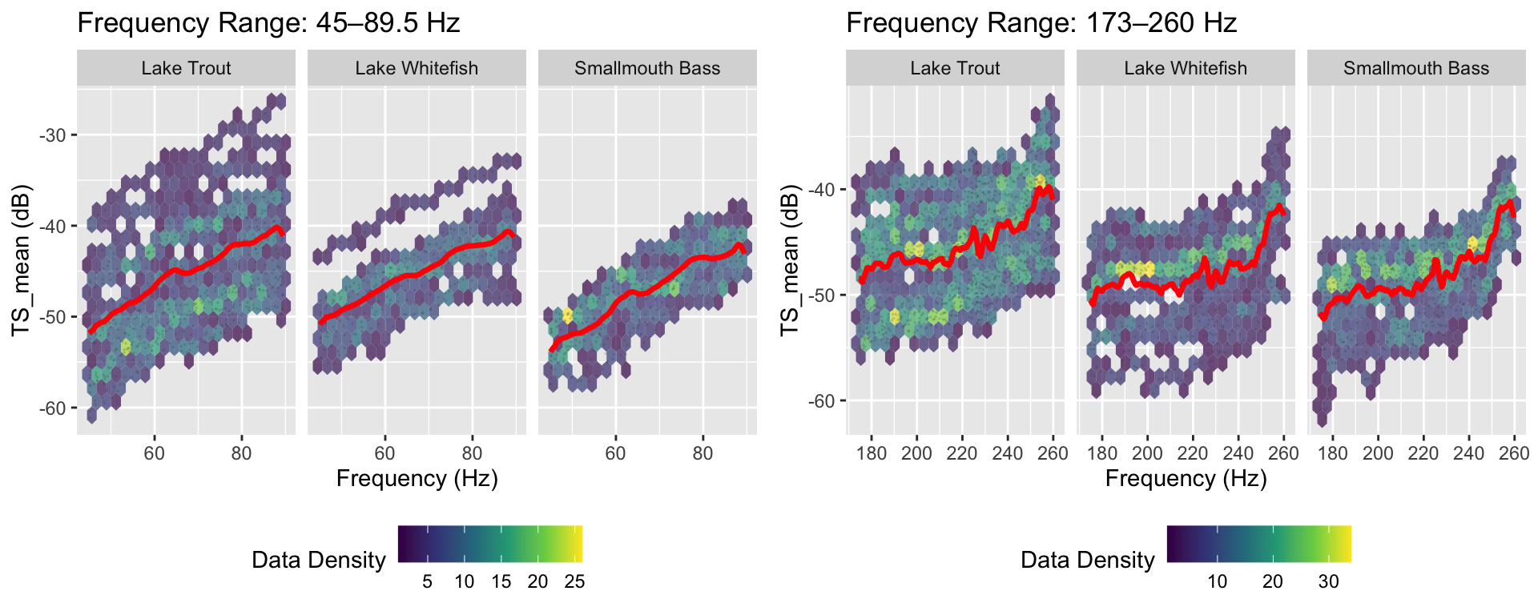
Data Exploration

Slide 8
Proposed Methods
Multinomial Regression
Simple baseline model to test linear relationship in the data
Provide interpretable results and computationally lightweight
Random Forest
Handle hierarchical structure of high-dimensional fish signatures
Robust to noise and overfitting, reveal feature importance
Deep Neural Network
Learn complex, non-linear hierarchical interactions
Automatic layered abstraction
LSTM (Long Short-Term Memory)
Designed for sequential data
Incorporate fish habitat context for temporal patterns
Notes:
Multinomial Regression
Simple baseline model to test linear relationship in the data
Provide interpretable results and computationally lightweight
Random Forest
Handle hierarchical structure of high-dimensional fish signatures
Robust to noise and overfitting, reveal feature importance
Deep Neural Network
Learn complex, non-linear hierarchical interactions
High accuracy with
LSTM (Long Short-Term Memory)
Designed for sequential data
Incorporate fish habitat context for temporal patterns

Slide 9
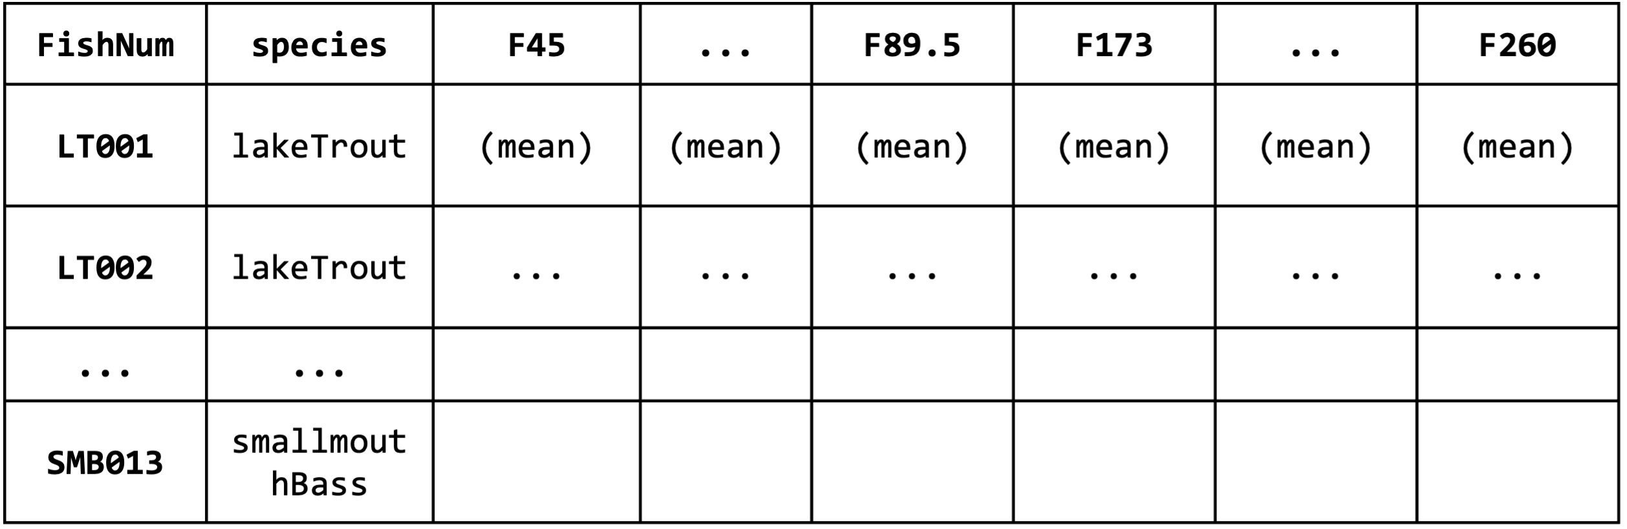
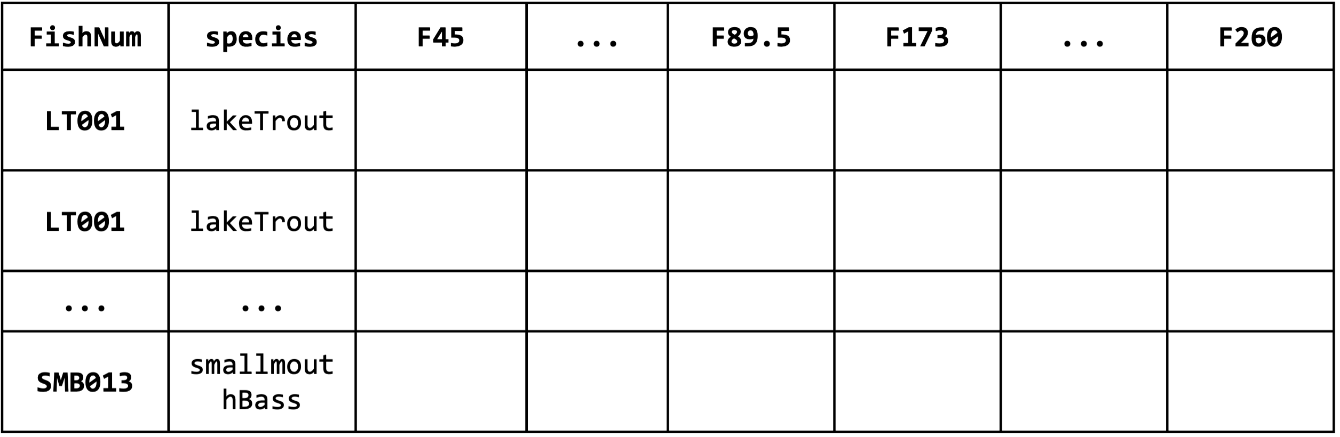
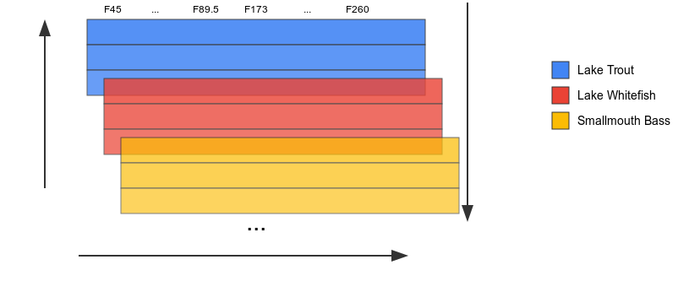
Proposed Methods – Input Data
Multinomial Regression
Mean TS for each fish
Standardized and apply PCA (first two PCs)
Dim: 43 x 267
Random Forest
Raw data
Dim: 14392 x 267
Deep Neural Network
Raw data
Dim: 14392 x 267
LSTM
Standardized 3D array
Dim: 43 x 1619 (N) x 267
LT001
Ping1
Ping2
Frequency response (Dim 3)
Ping3
Fish ID (Dim 1)
LWT001
SMB013
Ping sequence (Dim 2)
Notes:
Multinomial Regression
Simple baseline model to test linear relationship in the data
Provide interpretable results and computationally lightweight
Random Forest
Handle hierarchical structure of high-dimensional fish signatures
Robust to noise and overfitting, reveal feature importance
Deep Neural Network
Learn complex, non-linear hierarchical interactions
High accuracy with
LSTM (Long Short-Term Memory)
Designed for sequential data
Incorporate fish habitat context for temporal patterns

Slide 10
Results
Multinomial Regression
Accuracy: 37.5%
Apply PCA and uses first two PCs (Cum Var: 95.9%)
Random Forest
Accuracy: 62.5%
Mtry: 20, n_Trees: 400, min_n: 5
Actual Predicted | LT | LWT | SMB
LT | 3 | 1 | 2
LWT | 0 | 0 | 0
SMB | 1 | 1 | 0
Actual Predicted | LT | LWT | SMB
LT | 4 | 1 | 2
LWT | 0 | 1 | 0
SMB | 0 | 0 | 0
Deep Neural Network
Accuracy: 62.5%
3 hidden layer, epochs: 128
LSTM
Accuracy: 62.5%
2 LSTM layers, 1 hidden layer, epochs: 21
Actual Predicted | LT | LWT | SMB
LT | 4 | 1 | 2
LWT | 0 | 1 | 0
SMB | 0 | 0 | 0
Actual Predicted | LT | LWT | SMB
LT | 2 | 0 | 1
LWT | 1 | 2 | 0
SMB | 1 | 0 | 1
Notes:
Multinomial Regression
Simple baseline model to test linear relationship in the data
Provide interpretable results and computationally lightweight
Random Forest
Handle hierarchical structure of high-dimensional fish signatures
Robust to noise and overfitting, reveal feature importance
Deep Neural Network
Learn complex, non-linear hierarchical interactions
High accuracy with
LSTM (Long Short-Term Memory)
Designed for sequential data
Incorporate fish habitat context for temporal patterns

Slide 11
Future STEPs
Enhanced LSTM with attention mechanism
  Focus on most informative signal
  Less focus on the less important signal
Incorporate Fish characteristics
  Signal variation within species might relate to weight, total length, gender, etc.
More details can be view at GitHub: Fish Classification

Slide 12
Thank you

